Slide 1
Data Governance Framework Proposal
Michigan Avenue Fitness Center
Consulting Firm: Northwestern and Company
Partners: Jamia Russell, Patrick Eckland, Satvik Yagnamurthy, Yemi Adetutu, Yinwei Wang

Slide 2





Northwestern and Company - Leadership Overview
Patrick Eckland
Position: Partner
Experience: Financial Planning, Analysis, and Accounting
Education: B.S. in Finance, M.S. in Data Science Candidate, MBA Candidate.
Satvik Yagnamurthy
Position: Partner
Experience: Growth Strategy, M&A, and Program Management
Education: B.S. in Industrial Engineering, M.S. in Data Science Candidate
Yemi Adetutu
Position: Partner
Experience: Network Optimization and Business Development
Education: B.S. in Statistics & Mathematics, M.S. in Data Science Candidate
Yinwei Wang
Position: Partner
Experience: Marketing, Venture Capital, and CPG
Education: B.A. in Human Resources, MBA, M.S. in Data Science Candidate
Jamia Russell
Position: Partner
Experience: Account Management, Data Analytics, Legal
Education: B.A. in Criminology, Psychology, Chinese, M.S. in Data Science Candidate

Slide 3
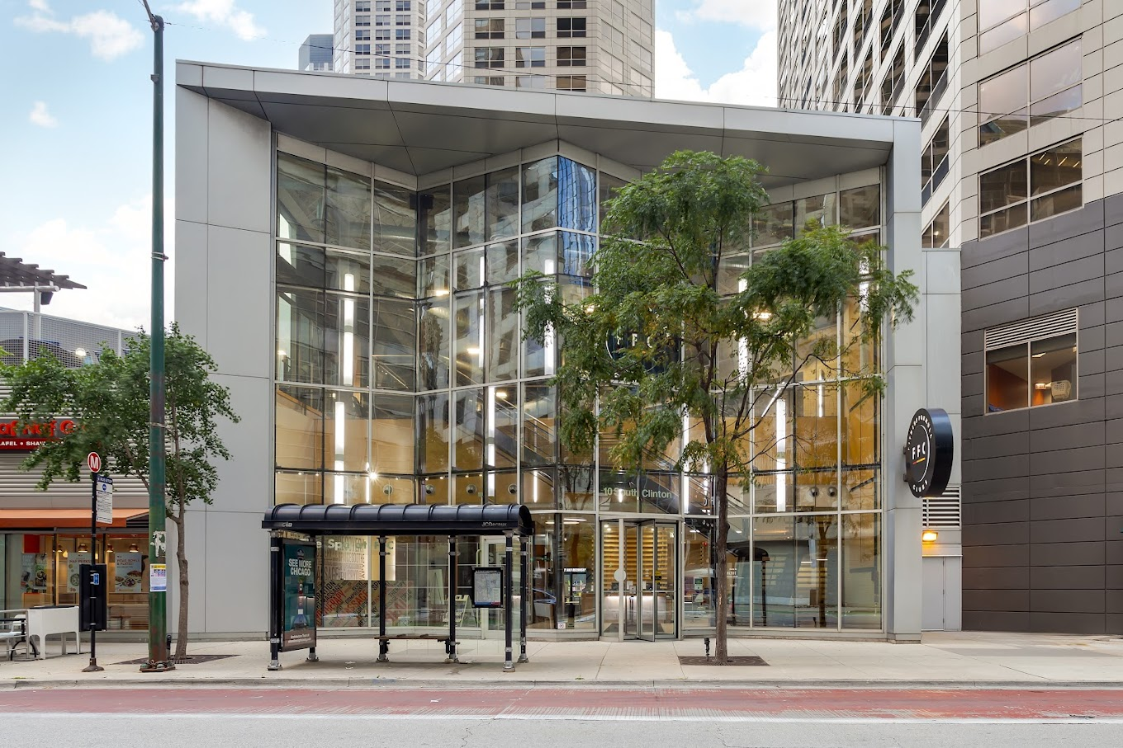
Company Overview
Comprehensive Offerings: Michigan Avenue Fitness Center (MAFC) provides advanced equipment, diverse fitness programs, community events, and nutrition services to support all fitness levels
Revenue Model: MAFC’s income streams include memberships, personal training, classes, events, and customized plans, with tiered pricing to meet varied customer needs
Sensitive Data Handling: MAFC collects, stores, and analyzes sensitive data, such as health records, usage patterns, and payment details, to deliver customer-focused services
Focus on Data Governance: Approaching 2025 Q1, the new MAFC CEO intends on emphasizing a strong data governance framework to ensure data security, privacy, quality, and operational integrity

Slide 4
Responsibilities and Services
Provides best-in-class exercising eco-system to all fitness levels
Features advanced facilities and equipment
Regular maintenance
Sanitization
Offers various fitness programs including:
Fitness classes (e.g. yoga, HIIT, etc.)
Customized training and coaches services
Community challenges
Meal and nutrition planning
Fitness level analysis and goal planning
Delivers strong customer experience
Fitness technology (e.g. apps, virtual options, wearable integration)
Flexible payment plan
Additional amenities (e.g. spa, juice bars, gear stores, etc.)

Slide 5
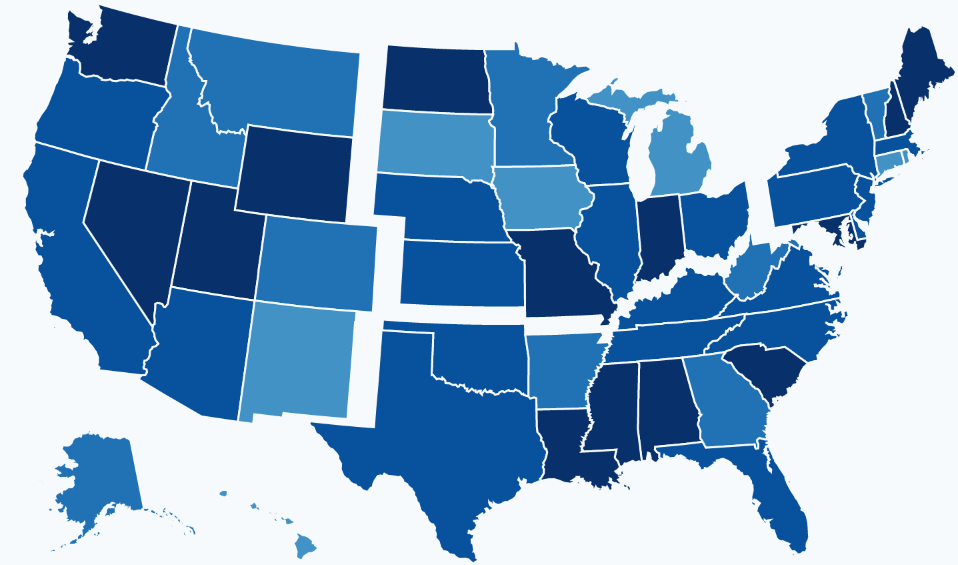


Company Size
How big is Michigan Avenue Fitness Center?
Number of Gyms: 1
Active Memberships: 3,196
Company Employees: 105
Area: ~15,000 square feet
Notes:
Thanks Yemi…
Michigan Avenue Fitness Center offers an extensive range of services.
There are 105 employees and just over 3k active members at its first and only location. It spans 15,000 feet in Chicago’s historic Gold Coast area.
Right now with one location and a new/eager CEO, it is an opportune time to implement a data governance framework before hopes of expansion.
Now let’s get into the current state and how Michigan Ave measures up against an optimal environment for such implementation.

Slide 6


Current State of Data Governance
Executive Support and Alignment
Centralized Data Management Office (DMO)
There is currently a strong backing from the new CEO for ensuring that data governance initiatives are implemented and aligned with the fitness center’s business goals.
Despite this backing, a DMO will need to be established prior to implementing a data governance framework.
Data Ownership and Stewardship
Data ownership is not clearly assigned across departments (membership, fitness programs, finance).
Policies and Processes
Organization-wide data governance policies and standards have not been established yet despite clear data ownership.
Notes:
1) Michigan Avenue Fitness Center’s new CEO intends on hiring a consulting firm to incorporate data governance initiatives and to create a framework that aligns with its goals. These goals include focusing on enhanced customer engagement, improved operational efficiency, and meeting regulatory compliance.
2) Our firm strongly suggests that the leadership team begins forming a Centralized Data Management Office to oversee implementation and execution of a data governance framework. No such council currently exists. This will be critical for managing policies, processes, roles, and technology to maintain data integrity, security, and accessibility, while promoting cross-departmental collaboration.
3) Data ownership is not clearly established which makes it difficult to assign stewardship roles for people who can report directly to the DMO from each department. This is something that needs to improve as stewards will be required to maintain data quality, security, privacy, and ensure compliance with regulations.
4) Governance policies and processes will need to be established as well, at each level of ownership, to ensure proper management and security. There is no current tracking of data quality and limited enforcement of security and access controls.

Slide 7
Accomplishments Towards Modernization
1
Data Governance Council
Formation of a governing body within MAFC that will oversee and guide data governance initiatives
2
McKinsey Data Governance Framework
Implementation of key components designed to ensure effective and efficient use of data within the organization
Data Governance Council
McKinsey Data Governance Framework
Guiding Principles - ICARE Core Values
3
Guiding Principles - ICARE Core Values
Integrity - ensure data accuracy and consistency
Commitment - from all levels of the organization
Advocacy - promoting importance across the organization
Respect - stressing data privacy
Excellence - obsession with continuous development of best practices
1
2
3
Notes:
Based off our current state assessment, we see three accomplishments that will have Michigan Avenue Fitness Center well on its way towards modernization: establishing a data governance council, implementing the McKinsey Data Governance Framework, and following the ICARE Core Values guiding principles.
A data governance council will be established to oversee strategizing data governance programs, raise awareness for the importance of data governance, approve policies, prioritize projects, enable ongoing support, and ensure data quality and compliance. This council will include cross-functional representation to ensure that the entire organization is on board.
The McKinsey Data Governance Framework consists of components that will be implemented to achieve data governance. These components include Leadership and Sponsorship (starting with the Data Governance Council), Governance structure, policies and procedures, Data Stewards (functional leaders that report directly to the council), Technology solutions, and integration with business goals
The ICARE Core Values are as follows:
Integrity - we will implement data validation processes and audits around those processes to ensure data accuracy and consistency.
Commitment - we will get all levels of the organization on board and the data governance council will assist with dedicating resources to manage data and train employees on data governance policies
Advocacy - we will promote the importance of data governance across the organization to establish a consistent culture that prioritizes it
Respect - we will implement strict access controls to safeguard sensitive information. This will build trust with stakeholders and protect the organization from legal and reputational risks.
Excellence - obsession with excellence around data governance, through continuous development and improvement of best practices is critical. This includes integrating and leveraging advanced technologies and granting access across the organization.
With that, I’ll pass it off to Satvek to go over the Scope of Work

Slide 8
Proposed Engagement - Scope of Work (SOW)
Michigan Avenue Fitness Center RFP: Michigan Avenue Fitness Center has requested a proposal to engage Northwestern and Company in a data governance engagement aimed at assessing their current state, identifying gaps, and providing actionable recommendations. Objectives are outlined in the accompanying table.
Item | Objective | Description
1 | Current State Assessment | Evaluate the fitness center’s existing data governance framework, focusing on key areas such as membership data, fitness program metrics, and operational records to identify strengths and inefficiencies
2 | Gap Analysis | Identify gaps between current data practices and best practices for managing fitness-related data, including membership privacy, payment security, and data-driven service customization
3 | Risk and Compliance Evaluation | Assess risks associated with handling sensitive client information, including health data and payment details, ensuring alignment with industry regulations like HIPAA and PCI-DSS
4 | Remediation Plan and Development | Develop tailored strategies to address gaps, improve data quality, secure client information, and enable more effective use of data for operational and marketing insights
5 | Implementation Roadmap | Provide a clear roadmap for implementing recommended improvements, prioritizing actions such as securing customer data, optimizing analytics systems, and enhancing reporting capabilities
6 | Training and Change Management | Train staff on best practices for managing client data and introduce processes to ensure adherence to new governance standards, with a focus on building trust through secure and ethical data use

Slide 9
Data Governance Framework
1
Secure Leadership Commitment and Strategic Alignment
2
Establish a Data Management Office for Oversight
3
Define Data Ownership and Accountability
Secure executive support for data governance aligned with business goals
Prioritize data-driven strategies for customer engagement, operational efficiency, and regulatory compliance
Establish a central DMO to oversee data governance framework implementation
DMO to manage policies, processes, roles, and technology for data integrity, security, accessibility, and cross-functional collaboration
Implement a robust data governance framework with clear data ownership, stewardship, and quality assurance processes
Prioritize regulatory compliance (HIPAA, PCI-DSS) to protect sensitive data
4
Create Data Policies, Standards, and Compliance Protocols
5
Implement Data Management Processes and Technology
6
Cultivate a Data-Driven Culture and Embed Governance
Implement a comprehensive data governance framework to protect sensitive data
Ensure compliance with industry regulations (data privacy, health standards) through strict policies and protocols
Deploy scalable data management tools to ensure data quality, track lineage, and enforce security controls
Enable real-time monitoring of fitness operations, member health data, and transactions while enhancing data governance
Cultivate data-driven decision-making by embedding governance practices into operations and empowering staff to uphold data integrity
Train employees on the importance of data governance for service excellence, privacy, and member satisfaction

Slide 10


Baseline Review Assessment
Background:
77% of organizations struggle with data quality issues, impacting decision-making and efficiency
(AI Data and Analytics Network, 2024)
Sensitive data security and access control remain key concerns for many organizations
(Identity Defined Security Alliance, 2023)
Data Governance Maturity Model:
Gartner’s Data Governance Maturity Model - a framework that evaluates data governance maturity across five stages, from initial (ad-hoc) to optimized (integrated processes)
The Data Governance Institute (DGI) Maturity Model - a model with five stages that focuses on assessing key aspects of data governance, including policies, data management processes, and technology integration
IBM’s Data Governance Maturity Model - Multi-stage model that assesses governance maturity in critical areas such as data quality, security, and compliance, with an emphasis on structured processes and technology integration

Slide 11
Current Maturity Score
Model | Score | Description |  | Client Application | Limitations
Gartner Maturity Model | 60 | Evaluates data governance maturity across stages, focusing on alignment with business strategies and outcomes |  | Highlights need for leadership alignment and integration with HIPAA and PCI-DSS standards | May overlook operational nuances specific to fitness centers
DGI Data Governance Framework | 65 | Offers a structured approach covering 10 components, such as roles, policies, and data lifecycle management |  | Useful for defining ownership, processes, and compliance monitoring for sensitive member data | Emphasizes process over strategic alignment
IBM Data Governance Council | 60 | Assesses governance maturity in 11 areas, integrating technology solutions and operational practices |  | Supports deploying tools like metadata repositories and profiling systems | Technology-heavy, which might underrepresent cultural or leadership-related challenges
Michigan Avenue Fitness Center received a 62% in their data governance maturity assessment, indicating foundational practices in digitization and data security. However, further improvements are needed in data quality, compliance, and trust. By leveraging the expertise of Northwestern and Consulting services, an optimal plan can be implemented to advance maturity to the highest level.

Slide 12
Remediating Gaps
Northwestern and Company conducted a client survey across 2 managers, 10 trainers, and 2 administrative members to assess the perceived importance of personal fitness data. The survey focused on key aspects such as data quality, integrity, and security. The results revealed a significant gap in the prioritization of data governance, highlighting the need to address this through a structured approach.
“How important is data to you?”
Roles | Health | Financials | Workout
Admin | 1.00 | 2.00 | 7.50
Manager | 9.45 | 6.45 | 9.90
Trainer | 6.09 | 4.01 | 7.89
Total | 5.84 | 4.07 | 8.12
To bridge these gaps and achieve a 90% maturity level, Northwestern and Company proposes targeted deliverables designed to align with our scope of work and framework. By implementing the following three steps, we aim to reduce leadership, operational, and technical challenges:
Applying the Correct Level of Governance (Leadership)
Optimized and Level Access Provisioning (Operational)
Enhanced Reporting and Management (Technical)

Slide 13
Deliverables
Northwestern and Company is prepared to elevate your fitness center’s data governance maturity to 90% with targeted deliverables. By aligning leadership with regulatory standards like HIPAA and PCI-DSS, establishing a Data Management Office, and implementing robust tools and policies, we will secure sensitive data and enhance operational efficiency.
Our tailored 13-month program combines expert guidance and staff training to build trust, streamline compliance, and position your fitness center as a leader in secure, data-driven decision-making.
Deliverable | Timeline | Description
Leadership Alignment with Standards | Short Term | Form an Executive Committee, align framework with HIPAA/PCI-DSS
Launch Data Management Office (DMO) | Short Term | Establish a DMO with defined roles, processes, and necessary technology
Assign Ownership and Accountability | Short Term | Designate departmental data ownership, appoint stewards, and implement monitoring
Define and Enforce Data Policies | Short Term | Create and enforce governance and security policies aligned with industry standards
Deploy Tools and Train Staff | Short Term | Implement data profiling tools, build a metadata repository, and train staff
Develop a Custom Fitness App | Long Term | Build a secure app to streamline operations, engage members, and enhance analytics

Slide 14
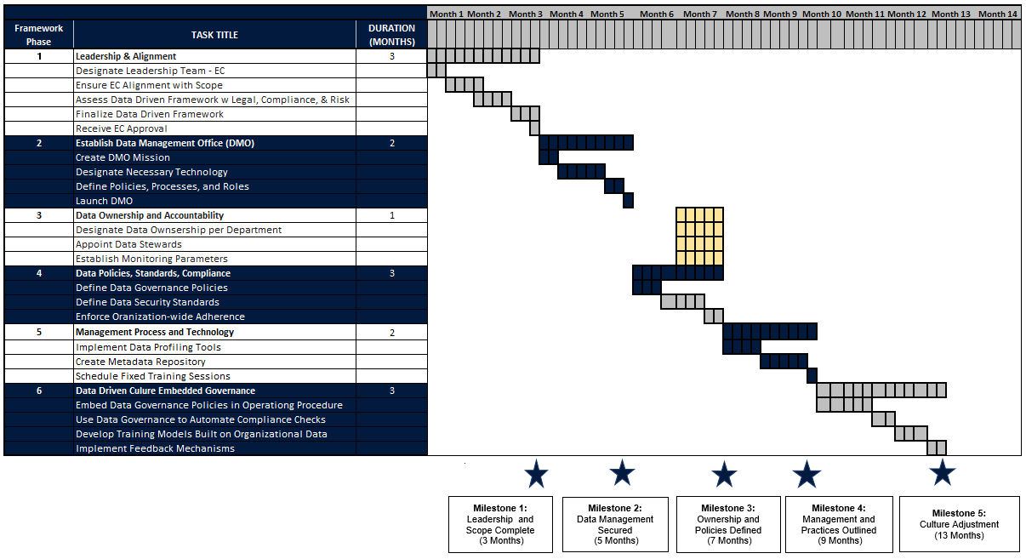
Proposed Timeline

Slide 15
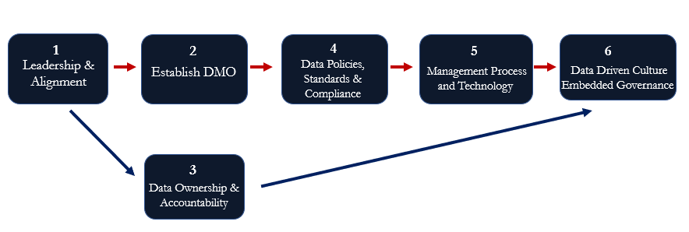
Critical Points
= Critical Path
= Slack

Slide 16
Measuring Success
Data Policies, Standards, and Compliance
Policies Approved by Leadership Accessible by Organization
Decrease in security incidents, increase in monitoring
Audit reports depicting increased compliance adherence
Management Process and Technology
Improvements in data quality
Data Discoverability and Usability Increased
Data Driven Culture Embedded Governance
Reduction in manual compliance check efforts
Actionable insights from feedback loops
Leadership & Alignment
All leadership roles filled
Approval by legal, compliance, and risk management teams
Documented formal approval of framework and application
Data Management Office of Oversight
DMO Structure
Budget and Resource Allocation for DMO operations
DMO Mission Reflects Organizational Goals
Data Ownership and Accountability
Performance review indicating success in roles
Functional monitoring mechanisms producing reports on data usage and compliance

Slide 17
Thank You!
Michigan Ave. Fitness Center

Slide 18
Appendix

Slide 19
References
Collibra. 2021. “Data Governance Council: What Is It and Why Do You Need One?”
https://www.collibra.com/us/en/blog/data-governance-council-what-is-it-and-why-do-you-need-one.
"Data Quality Crisis: New Survey Reveals 77% of Organizations Have Quality Issues," AI Data Analytics Network, accessed November 18, 2024,
https://www.aidataanalytics.network/data-governance/articles/data-quality-crisis-new-survey-reveals-77-of-organizations-have-quality-issues.
“Defining the 7 Core Principles of Data Governance.” DataGalaxy, June 28, 2024.
https://www.datagalaxy.com/en/blog/7-core-principles-of-data-governance/.
Data Governance Institute. "Data Governance Maturity Model." Data Governance Institute, last modified November 18, 2024.
https://www.datagovernance.com/dgi-data-governance-maturity-model.
EPA Data Governance Council Charter, January 31, 2022.
https://www.epa.gov/sites/default/files/2020-09/documents/epadatagovernancecouncilcharter.pdf.

Slide 20
References
Gartner. "Data Governance Maturity Model." Gartner, last modified November 18, 2024.
https://www.gartner.com/en/documents/3886395.
"IBM Data Governance Maturity Model." IBM, last modified November 18, 2024.
https://www.ibm.com/blogs/data-governance-maturity-model.
Identity Defined Security Alliance, "2023 Data Access and Security Survey," Identity Defined Security Alliance, 2023,
https://www.idsalliance.org/reports/2023-data-access-and-security-survey.
“McKinsey Data Governance Framework: 5 Steps to Use It.” Atlan, February 26, 2024.
https://atlan.com/mckinsey-data-governance-framework/.
Petzold, Bryan, Matthias Roggendorf, Kayvaun Rowshankish, and Christoph Sporleder. “Designing Data Governance That Delivers Value.” McKinsey & Company, June 26, 2020. https://www.mckinsey.com/capabilities/mckinsey-digital/our-insights/designing-data-governance-that-delivers-value.

Slide 21
Team Contribution
Jamia Russell - Supported the creation of the Proposed Timeline, Critical Points, and Measuring Success slides and references.
Patrick Eckland - Supported the creation of the Current State of Data Governance and Accomplishments Towards Modernization slides.
Satvik Yagnamurthy - Supported the creation of Proposed Engagement (SOW), Data Governance Framework, Baseline Review Assessment, Current Maturity Score, Remediating Gaps, Deliverables, and Team Contribution slides.
Yemi Adetutu - Supported the creation of the Remediating Gaps and Deliverables slides.
Yinwei Wang - Supported the creation of the Leadership Overview, Company Overview, Responsibilities and Services, and Company Size slides.
Whole Team worked together to schedule meetings via Zoom, make incremental updates throughout the deck, and practice presenting to ensure flow and structure while emphasizing the importance of incorporating a viable data governance framework.

